Slide 1
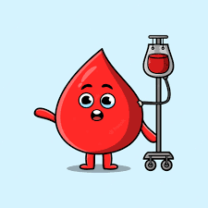
Blood Transfusion
By :N.Thubi Rahav

Slide 2

What is known as Blood transfusion?
    The transfer of blood from one individual to another.
  The person who donate blood is known as Donor.
  The person who receives blood is known as Recipient.
Key word:Transfusion
மாற்றம்

Slide 3
Compatibility of blood group
There are 4 blood groups
  A
  B
  AB
  o
The blood is divided by 4 groups by the protein factor
Compatibility of blood group is in the below table
Key word : Compatibility- nghUe;jf;$ba jd;ik

Slide 4
 | Recipient
D | Blood type | A | B | AB | O
O | A | ✓ | ✗ | ✓ | ✗
N | B | ✗ | ✓ | ✓ | ✗
O | AB | ✗ | ✗ | ✓ | ✗
R | O | ✓ | ✓ | ✓ | ✓
According to the table The blood group AB can receive blood from all type of blood. So It is called as a Universal Recipient.
According to the table The blood group O can receive blood from all type of blood. So It is called as a Universal Donor.

Slide 5
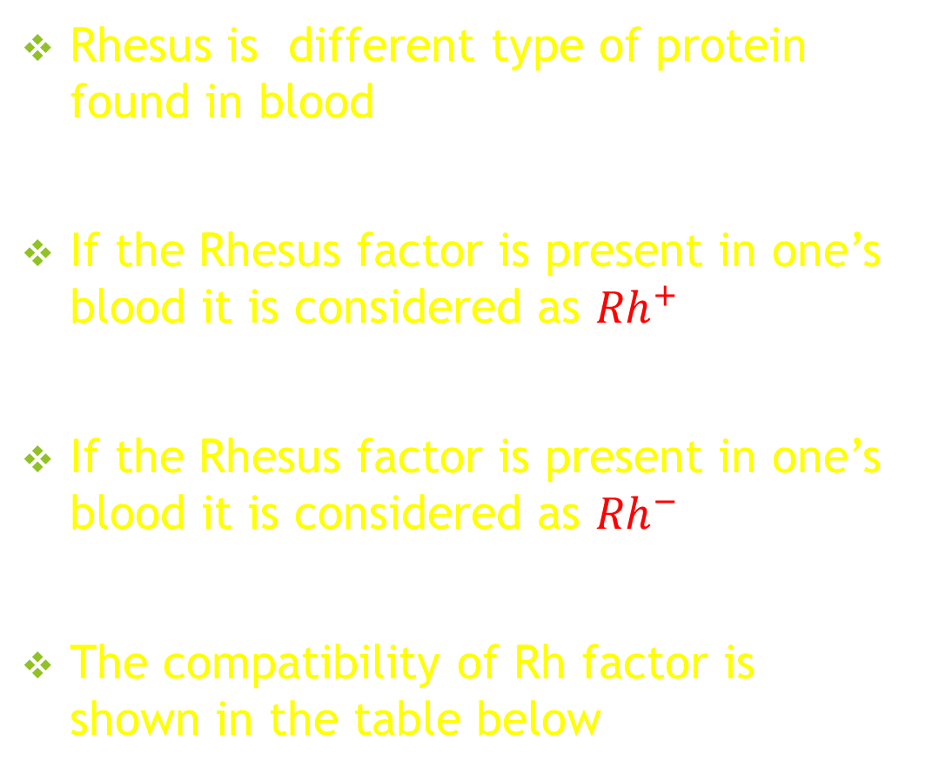
Compatibility of Rhesus Factor
Rhesus is different type of protein found in blood
If the Rhesus factor is present in one’s blood it is considered as ${Rh}^{+}$
If the Rhesus factor is present in one’s blood it is considered as ${Rh}^{−}$
The compatibility of Rh factor is shown in the table below

Slide 6
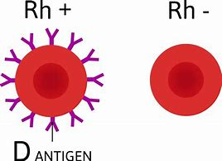
D | Rhesus Factor
O | Recipient
N | Rh+ |  | Rh-
O | Rh+ | ✓ | ✗
R | Rh- | ✓ | ✓

Slide 7
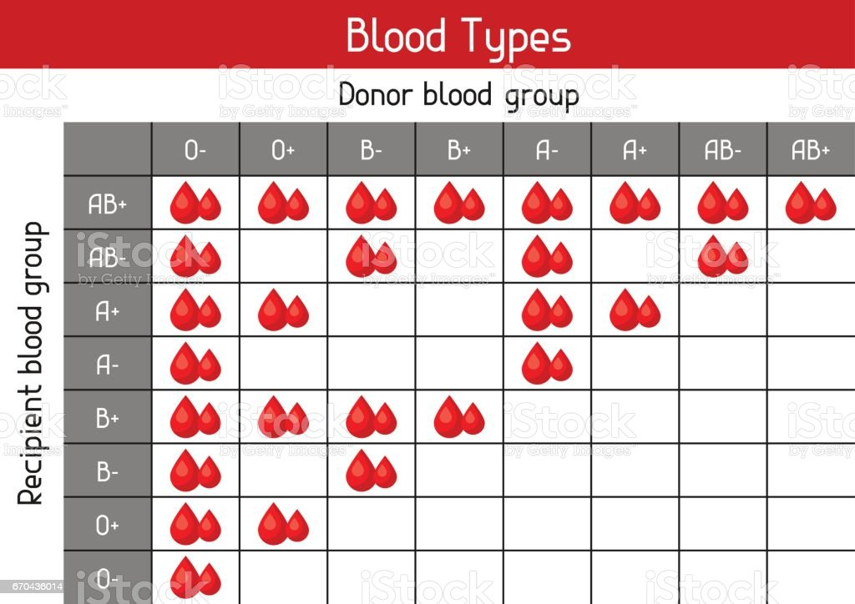

Slide 8
Blood Agglutination
Clumping of the transfused blood particles in the body of the recipient is called agglutination.
This happen when the blood group of donor and recipient are incompatible.

Slide 9


